Slide 1
Scholarsphere
Jaishyam Reddy Reddivari

Slide 2
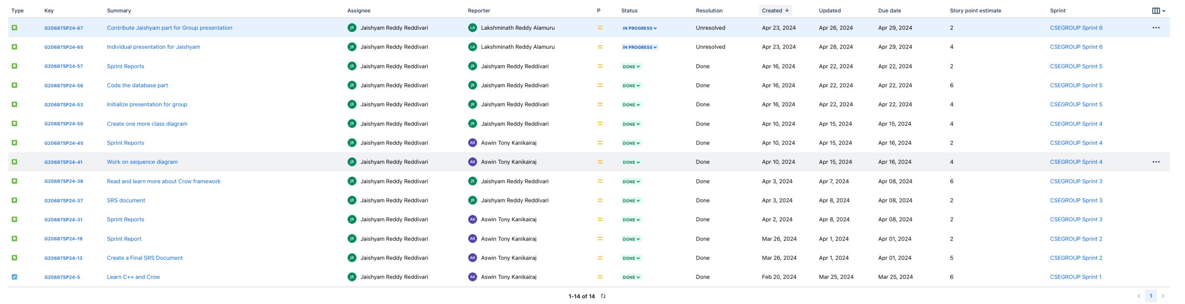
Stories

Slide 3
Sprint Overview
Sprint | Number of stories closed | Number of stories rolled over | Story points
Sprint 1 | 1 | 0 | 6
Sprint 2 | 2 | 0 | 7
Sprint 3 | 3 | 0 | 10
Sprint 4 | 3 | 0 | 10
Sprint 5 | 3 | 0 | 12
Sprint 6 | 2 | 0 | 6
Sprint 7 | 3 | 0 | 10
The average number of closed stories per sprint are 2.4.
The average number of stories rolled over are 0.
The total number of story points that I have logged are 61.

Slide 4
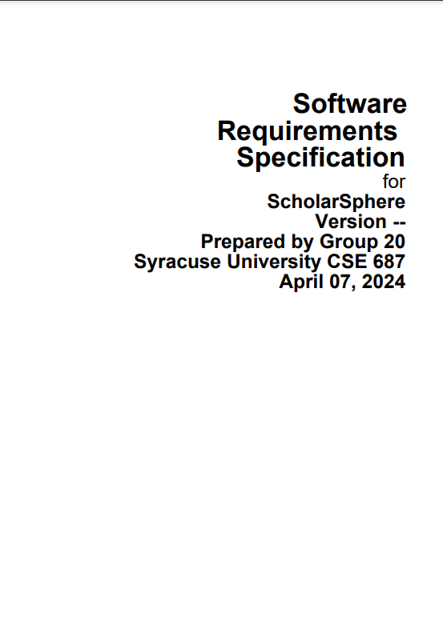
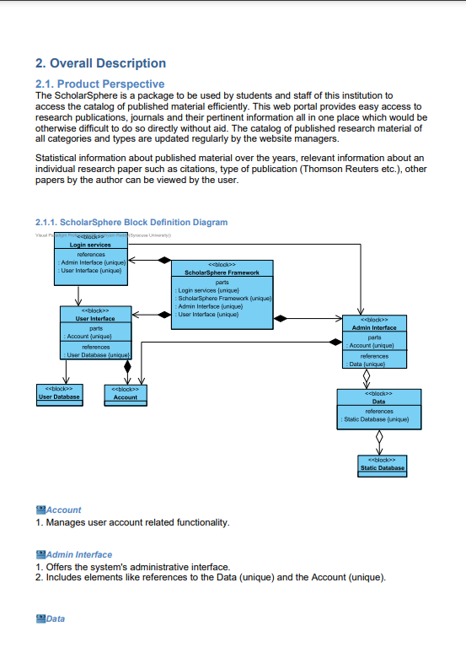
SRS Document
The SRS document is made using Visual Paradigm.

Slide 5
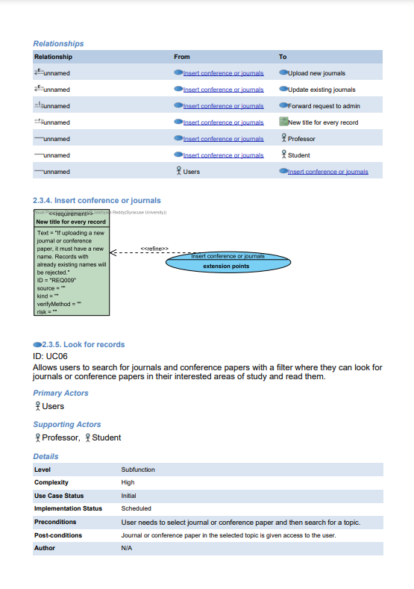
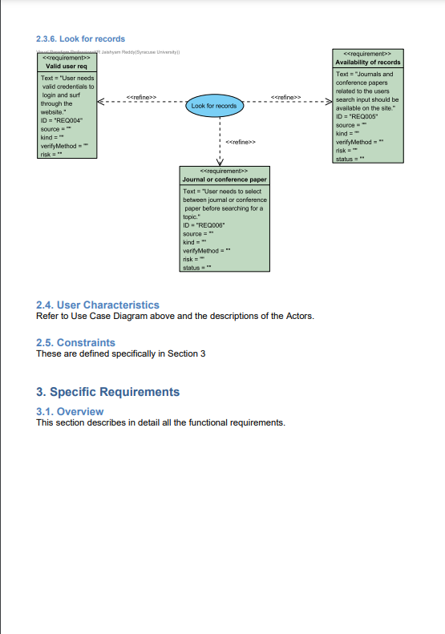
SRS Document
SRS Document GitHub link

Slide 6
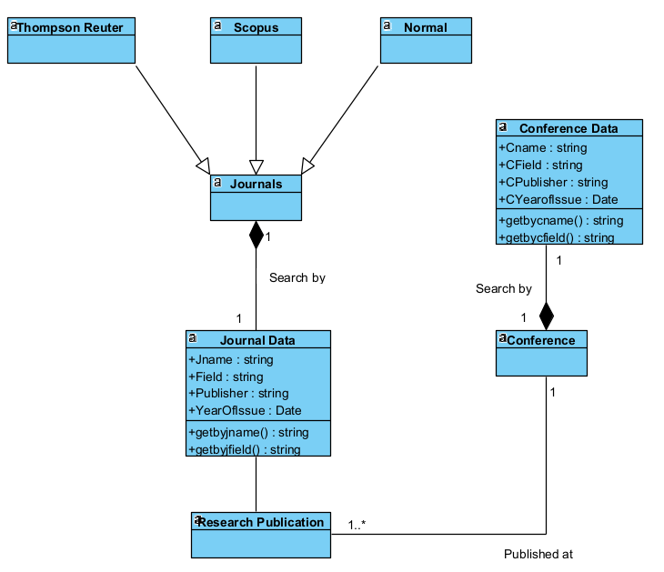
Class Diagram
Class Diagram GitHub link

Slide 7
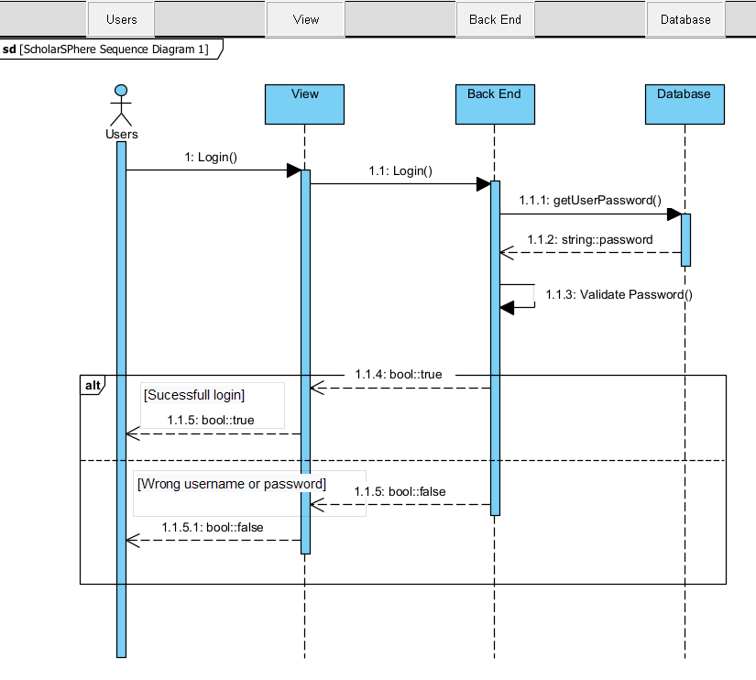
Sequence Diagram

Slide 8
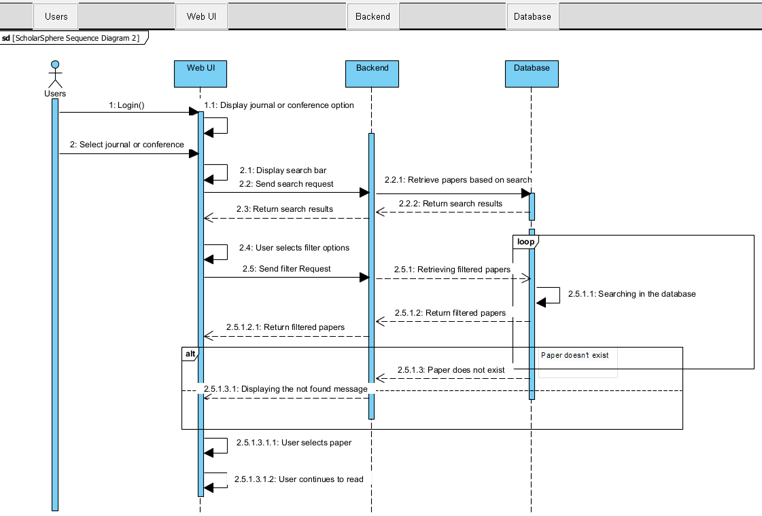
Sequence Diagram
Sequence Diagram GitHub link

Slide 9
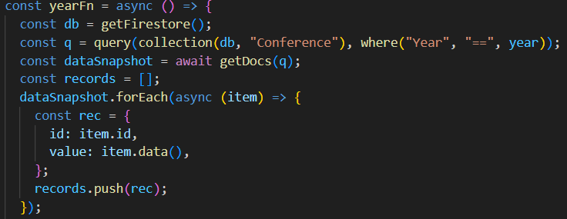
Database Code
This is a snippet from the entire code, this part of the code retrieves records from the database(Firebase) collection
named “Conference” based on a specific year.

Slide 10
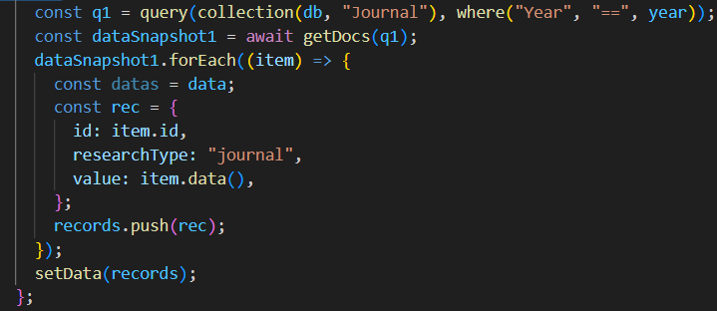
Database Code
This is a snippet from the entire code, this part of the code retrieves records from the database(Firebase) collection
named “Journal” based on a specific year.
Code GitHub link

Slide 11
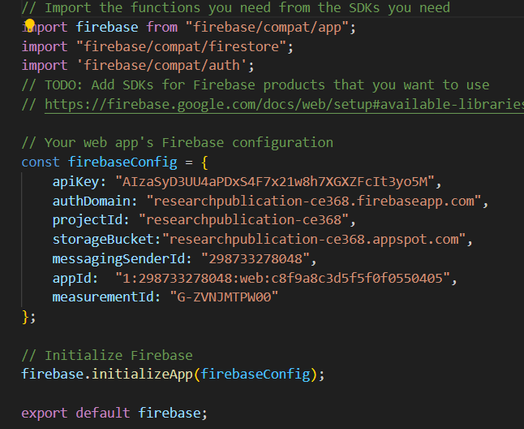
Database Code
This part of the code lets the web page to interact with the database on firebase.

Slide 12

When a user enters their credentials and hit login, a query is constructed to look for those credentials on the database
and validate them.

Slide 13
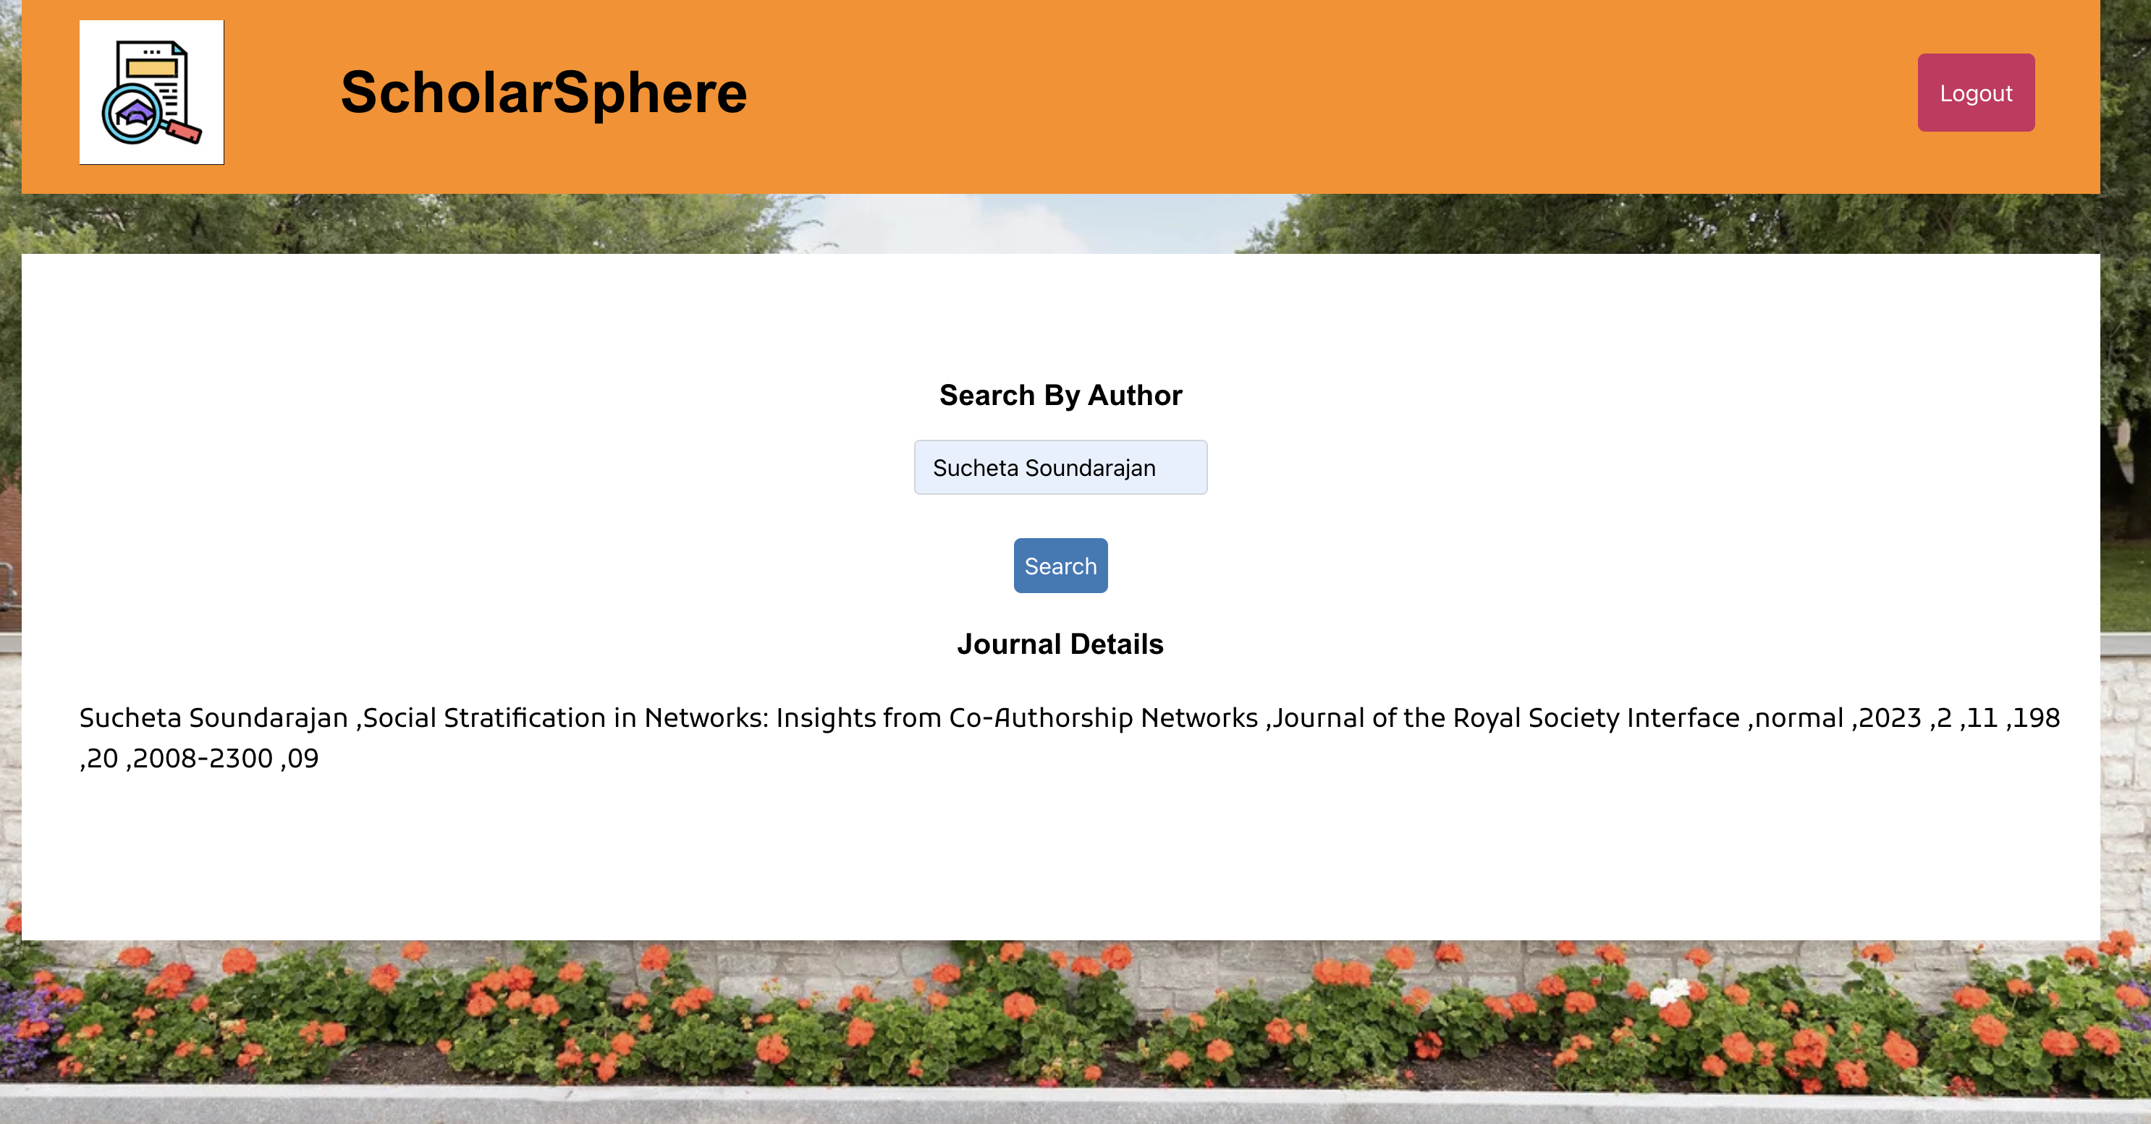
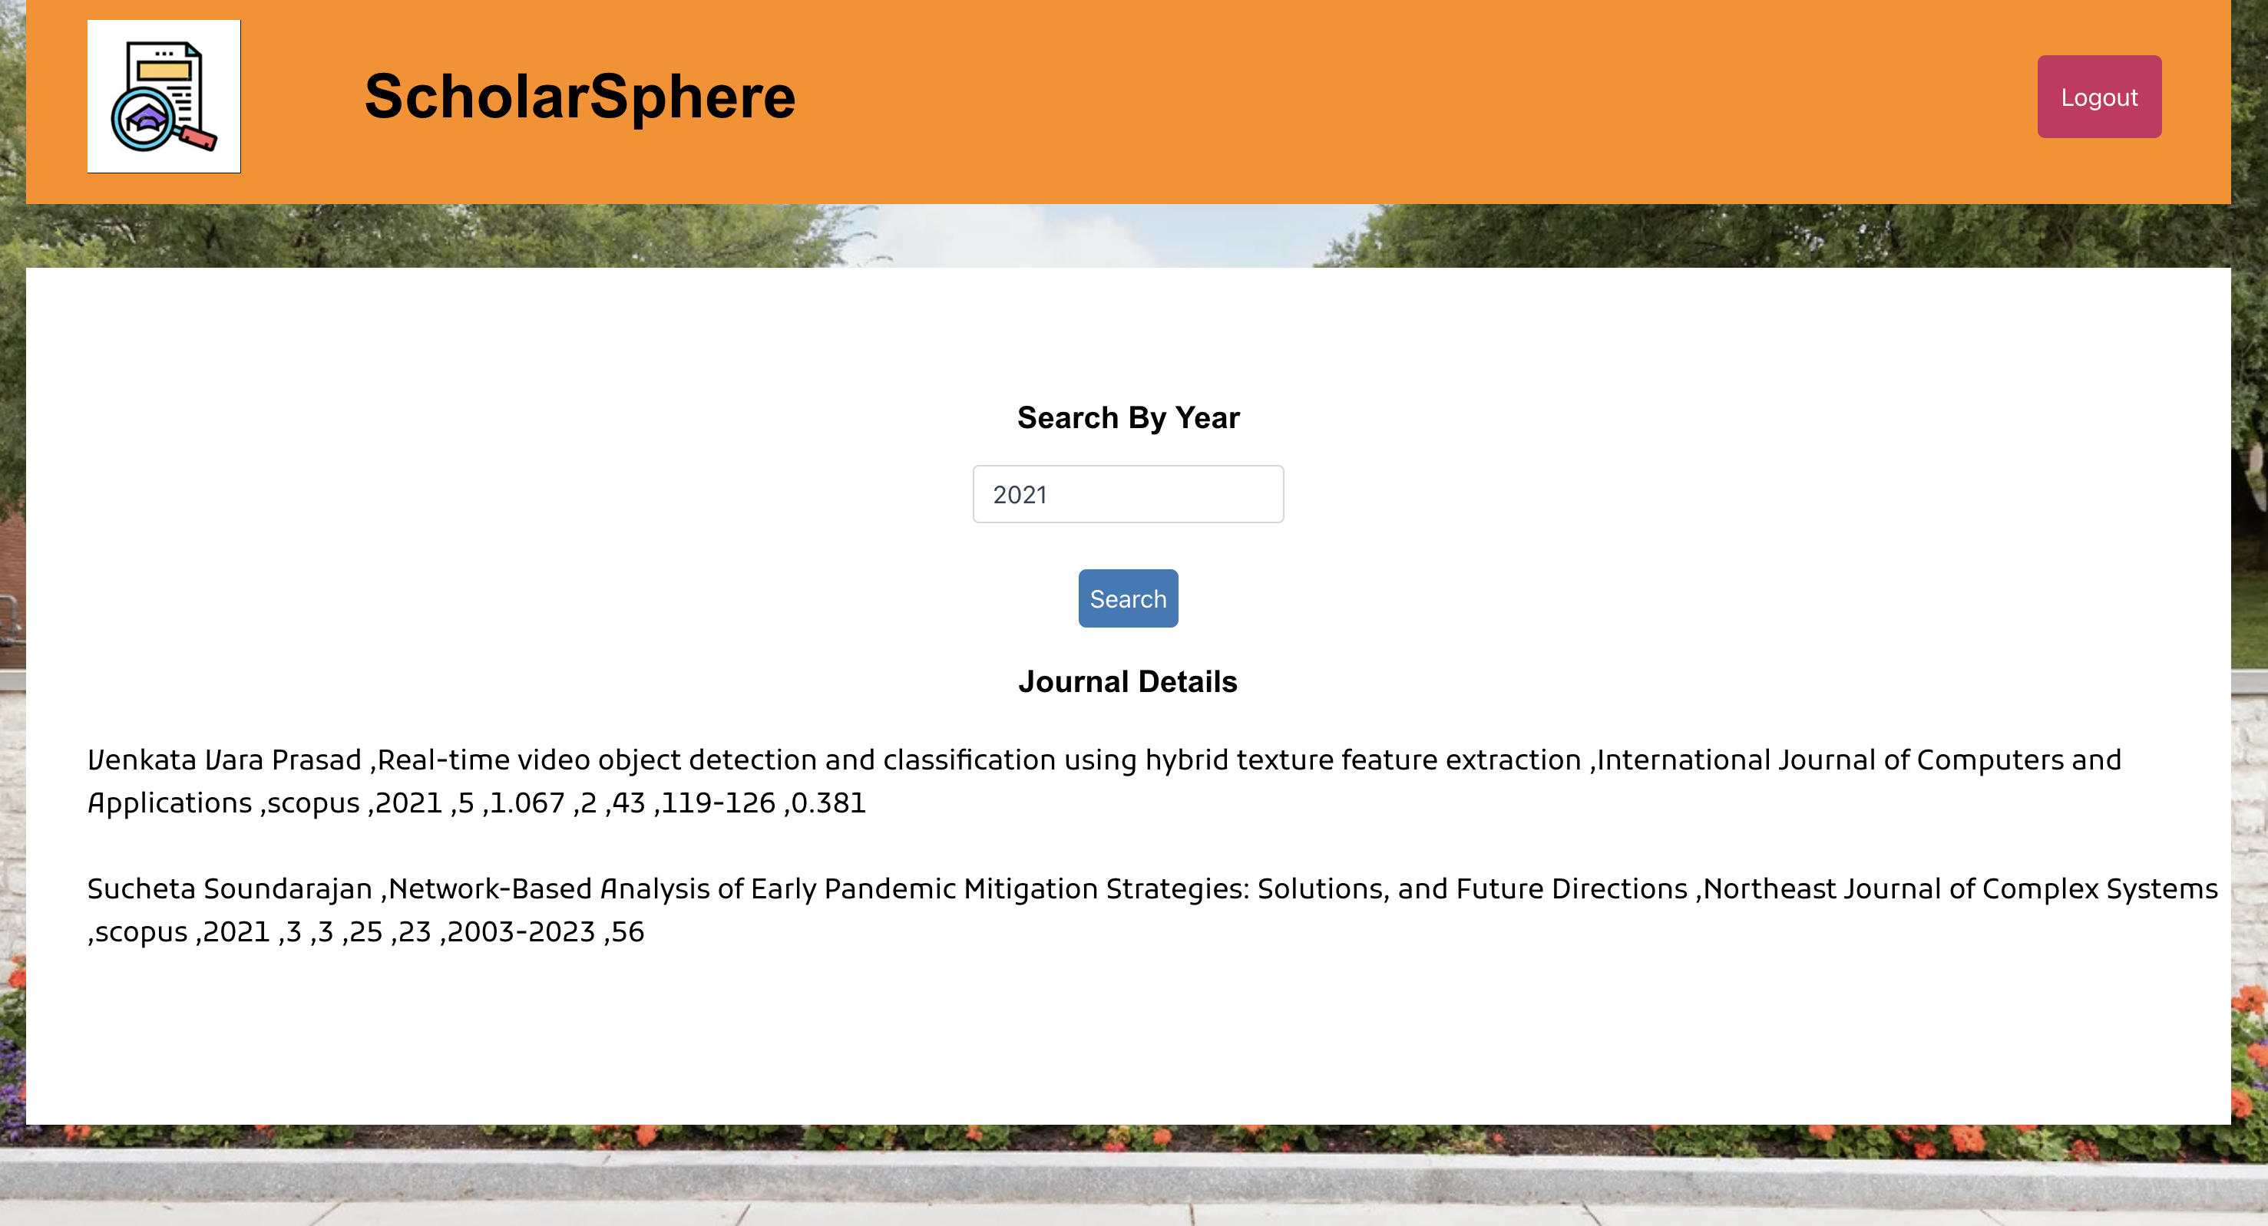

Slide 14
Thank you

